Slide 1
DenseNet
M SAI KIRAN
MT22MCS011

Slide 2
Problem Statement:
The objective of this project is to create an application that can detect class of images using only the image pixels. To achieve this goal, the following steps can be taken:
1.Download and extract the complete CIFAR10 onto the local system.
2.Utilize the dataset to train a Densely Connected CNN.
Test the trained model's ability to classify images from different classes using test data and evaluate its accuracy.

Slide 3
WHY DENSENET:
Vanishing gradient is a common issue in deep neural networks where the gradients (i.e., the partial derivatives of the loss function with respect to the network parameters) become very small as they are propagated backward through the network during the training process. This can make it difficult for the network to learn effectively, as the updates to the parameters become negligible.
DenseNet is a type of neural network architecture that addresses the issue of vanishing gradients by using skip connections, which connect all previous layers directly to the current layer. This means that the input to each layer includes the feature maps from all previous layers in the network.
By doing so, DenseNet allows for a more direct flow of gradient information throughout the network, allowing for better parameter updates during training. In addition, the use of skip connections helps to reduce the number of parameters in the network, which can help to mitigate overfitting and improve generalization performance.

Slide 4
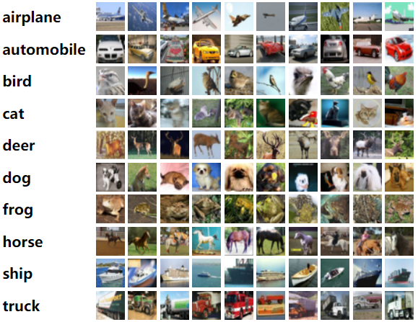
ABOUT DATA:
The CIFAR-10 dataset
The CIFAR-10 dataset consists of 60000 32x32 color images in 10 classes, with 6000 images per class. There are 50000 training images and 10000 test images.

Slide 5
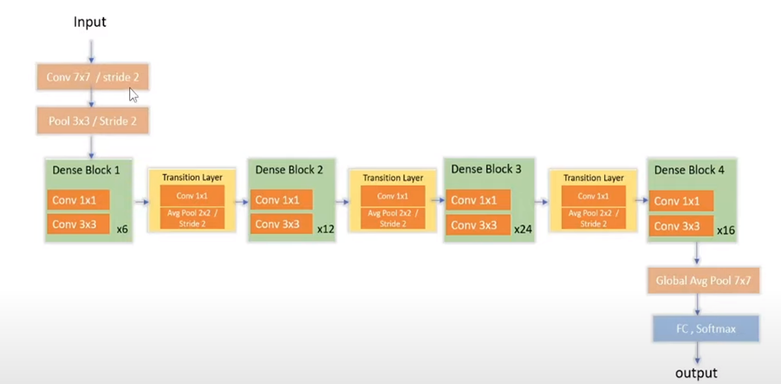
PICTURE OF THE NETWORK:

Slide 6
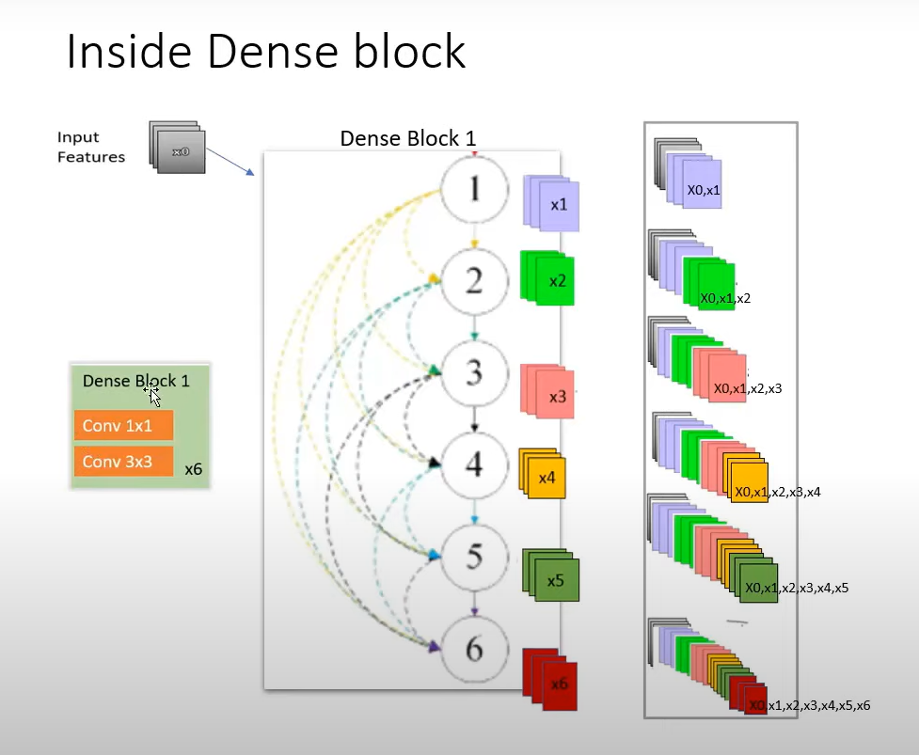
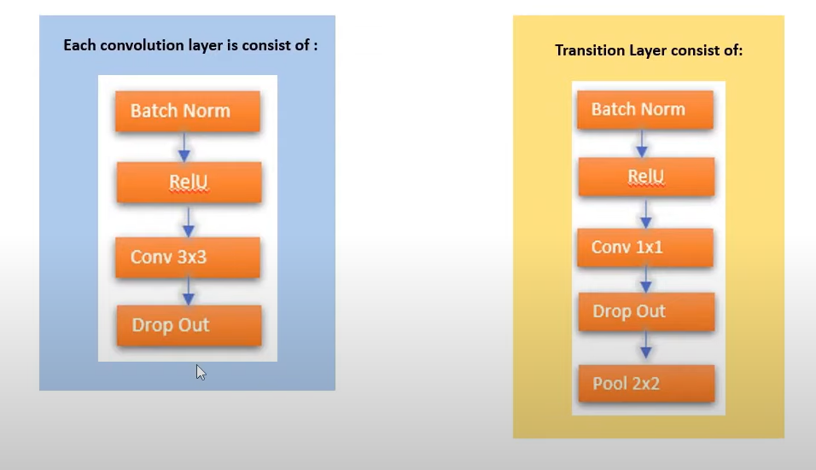

Slide 7
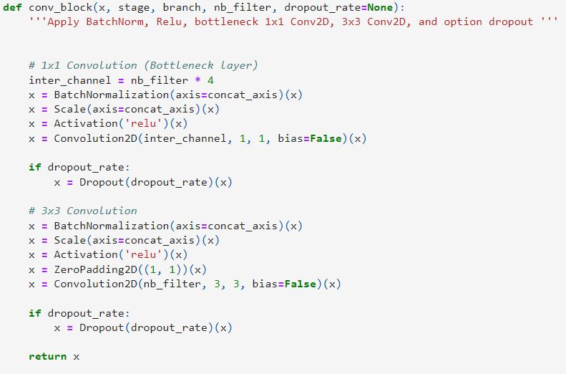
CODE FOR CONVOLUTION BLOCK:

Slide 8
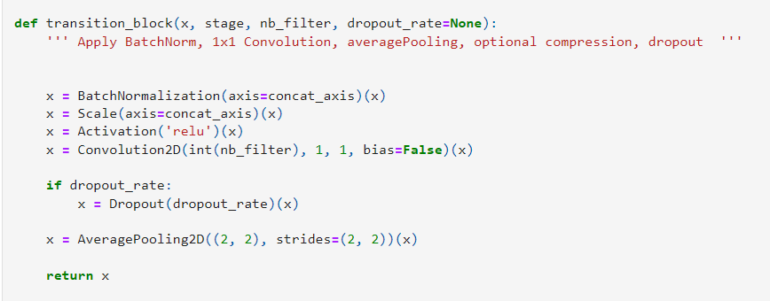
CODE FOR TRANSITION BLOCK:

Slide 9
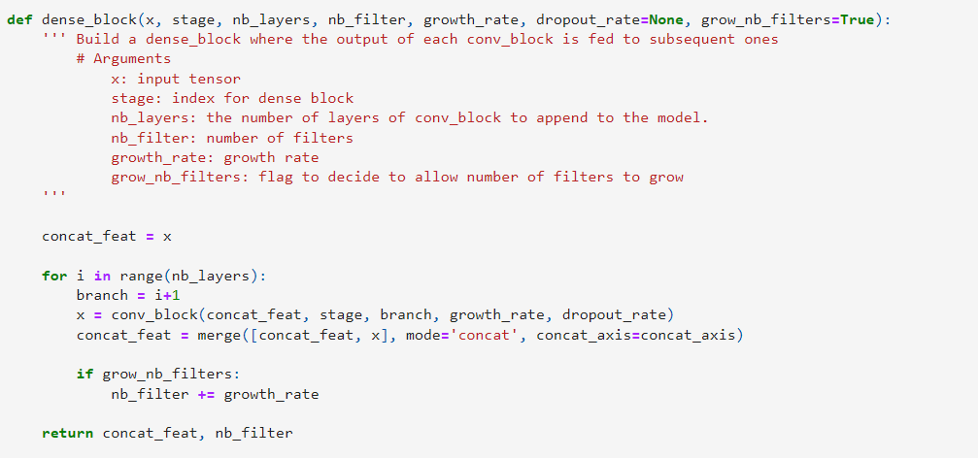
CODE FOR DENSE BLOCK:

Slide 10
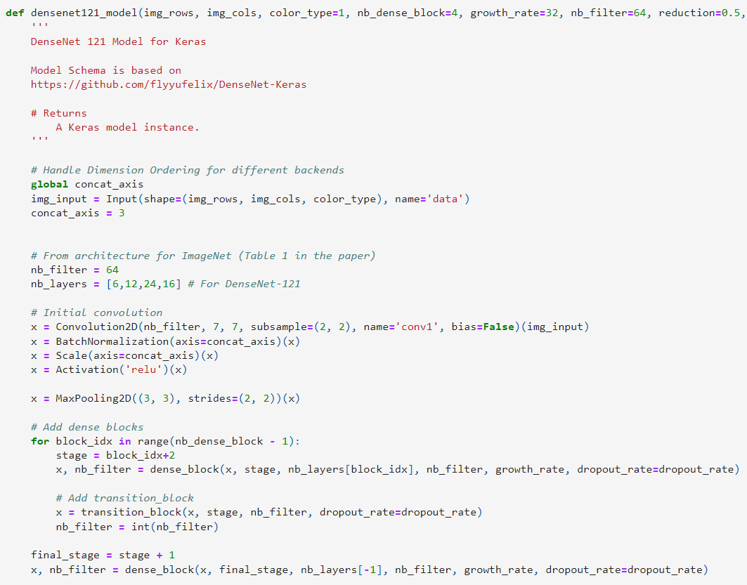
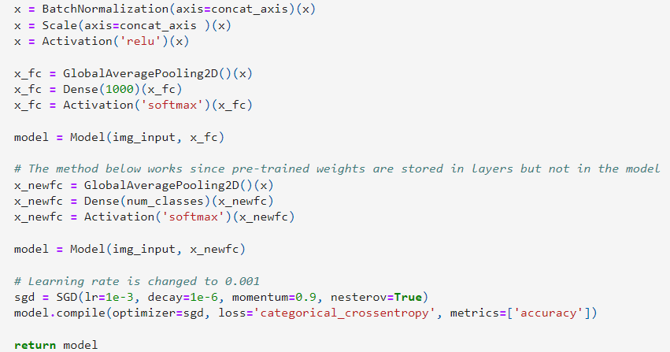

Slide 11
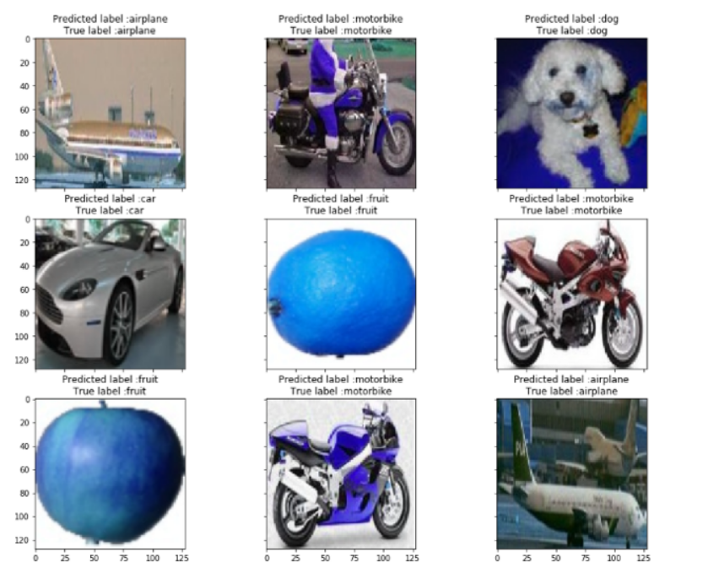
RESULTS:

Slide 12
REFERENCE:
G. Huang, Z. Liu, L. Van Der Maaten and K. Q. Weinberger, "Densely Connected Convolutional Networks," 2017 IEEE Conference on Computer Vision and Pattern Recognition (CVPR), Honolulu, HI, USA, 2017, pp. 2261-2269, doi: 10.1109/CVPR.2017.243.
https://www.kaggle.com/datasets/swaroopkml/cifar10-pngs-in-folders

Slide 13
THANK YOU

